Slide 1
Project Presentation of Back End Engineering Project (BEE) (22CS026)
On
Palette ~Whispers Of Soul
Akanksha Chopra 2210991212
Akriti 2210991220
Ananya Gupta 2210991258
Supervised By
Mr. Reshab Kumar
Department of Computer Science and Engineering,
Chitkara University, Punjab

Slide 2
Abstract
Palette was created to revolutionize the way art enthusiasts discover, showcase, and purchase artwork. It seamlessly integrates various auction-related features, including immersive virtual 3D galleries for browsing paintings and art pieces, real-time bidding, secure purchasing, and detailed artwork descriptions.
This platform provides an innovative and engaging environment, enhancing the user experience and connecting buyers, sellers, and collectors in a dynamic art marketplace. Built on the MERN stack, Palette ensures scalability, security, and ease of use, catering to the diverse needs of its users.
Additionally, it offers real-time bidding updates, personalized recommendations, and flexible management through an intuitive admin dashboard. With its modular architecture, Palette empowers administrators to manage galleries, bids, and transactions efficiently, making it the ideal platform for art auctions and showcasing creativity.

Slide 3
TABLE OF CONTENTS
Introduction
Problem Statement
Technical Details
Key Features
Our Design
Future Scope
Conclusion
References/Links used

Slide 4
INTRODUCTION
Palette is an all-in-one platform for seamless management of operations in art auctions and sales. This platform streamlines the entire process, from showcasing artwork in immersive 3D galleries and placing bids to secure payment processing and purchase tracking, ensuring a hassle-free experience for both art buyers and sellers.
By digitizing and automating these processes, Palette aims to enhance the efficiency and accessibility of the art marketplace, empowering users to explore, bid, and purchase artwork with ease while enabling sellers to reach a global audience.
It offers a wide range of features, including real-time bidding updates, user-friendly browsing of virtual galleries, detailed artwork descriptions, and an intuitive admin dashboard for managing listings, transactions, and user interactions.
Designed with scalability in mind, Palette is versatile enough to cater to individual artists, small galleries, or large auction houses, making it the ideal platform for connecting art enthusiasts and sellers worldwide.

Slide 5
Introduction
Objective
Palette aims to enhance the accessibility and efficiency of art auctions and sales by providing a comprehensive platform for managing artwork, auctions, and user interactions. With Palette, manual tasks and errors are reduced through streamlined processes, including virtual 3D gallery browsing, secure payment handling, and real-time bidding. This contributes to a seamless and engaging user experience, ensuring proper decision-making, coordination, and satisfaction for both buyers and sellers.
Simplifying Auction Operations: Palette simplifies operational challenges by automating tasks, reducing the potential for human error, and streamlining essential functions such as artwork listings, bidding, and purchase tracking. The platform empowers administrators and sellers to manage auctions effectively, enhancing operational efficiency.
Enhancing Customer Experience: Palette ensures that art enthusiasts and buyers enjoy a smooth and secure experience with real-time bidding updates, detailed artwork descriptions, and immersive virtual galleries. These features improve communication between buyers, sellers, and administrators, fostering better engagement and overall satisfaction.

Slide 6
Introduction
Significance
Palette revolutionizes the art auction experience by integrating cutting-edge technology with traditional art sales. It streamlines operations for artists, galleries, and auction houses through features like immersive virtual galleries, real-time bidding, and secure payment processing, ensuring efficiency and transparency.
Looking forward, Palette aims to expand with features such as personalized art recommendations, augmented reality previews, and global collaborations with galleries and museums. These innovations will further establish Palette as a modern, adaptable platform that connects art enthusiasts and empowers the global art community.

Slide 7
PROBLEM STATEMENT
2.1 Problem Statement
Traditional art galleries face significant challenges in adapting to a digital-first world. Emerging artists often struggle to showcase their work to a global audience, while collectors and art enthusiasts encounter barriers such as limited access to diverse collections and the inconvenience of physical visits.
Key issues include:
Restricted Reach: Artists lack the tools to extend their visibility beyond local audiences, limiting opportunities for recognition and sales.
High Operational Costs: Maintaining physical galleries involves significant expenses, making it challenging for smaller galleries to remain viable.
Fragmented Systems: The absence of centralized tools for managing exhibitions, auctions, and transactions creates inefficiencies for both artists and buyers.
Accessibility Barriers: Art lovers face challenges such as travel constraints, limited gallery hours, and restricted access to exclusive collections.
These challenges highlight the urgent need for a comprehensive online platform like Palette, which empowers artists with global exposure, provides collectors with seamless access to diverse artwork, and integrates advanced tools for managing exhibitions, bidding, and secure transactions.

Slide 8
Software requirements
Frontend Development:
Tailwind-CSS: These technologies will structure, style, and add interactivity to the user interface, ensuring dynamic content and a responsive design..
React.js: React.js will be the core frontend framework, enabling reusable components, efficient state management, and seamless integration with the backend.
React Router: React Router will handle navigation within the single-page application, offering a smooth user experience by enabling dynamic route changes.

Slide 9
Software requirements
Backend Development
Node.js and Express.js: The backend will be developed using Node.js with Express.js as the framework. Node.js is chosen for its non-blocking, event-driven architecture, which is well-suited for handling multiple requests efficiently. Express.js simplifies the process of building web applications and APIs. The Node.js API documentation and Express.js documentation will be used as key references.
Database Management
MongoDB with Mongoose: MongoDB will serve as the NoSQL database for storing unstructured data like patient records. Mongoose will be used to provide a schema-based solution for MongoDB, making it easier to enforce data validation and relationships. The MongoDB documentation and Mongoose guide will be essential resources.

Slide 10
KEY FEATURES
User-Friendly Interface: The platform offers an intuitive and easy-to-navigate interface, allowing users to explore art galleries, place bids, and make purchases effortlessly, enhancing the overall user experience.
Auction Management: A centralized system for managing auctions ensures smooth operations, allowing users to place bids, track artwork listings, and view auction statuses with minimal errors.
Real-time Bidding Tracking: Real-time updates on bids and auction statuses provide transparency and reduce uncertainty for bidders, improving trust in the platform.
Artist and Gallery Dashboard: A comprehensive dashboard allows artists and galleries to manage their listings, track bids, and monitor sales, all in one place, making operations more efficient.
Bid Optimization: The platform provides real-time updates and insights into bidding patterns, ensuring users are always informed, enhancing the auction experience.

Slide 11
Our Design

Slide 12
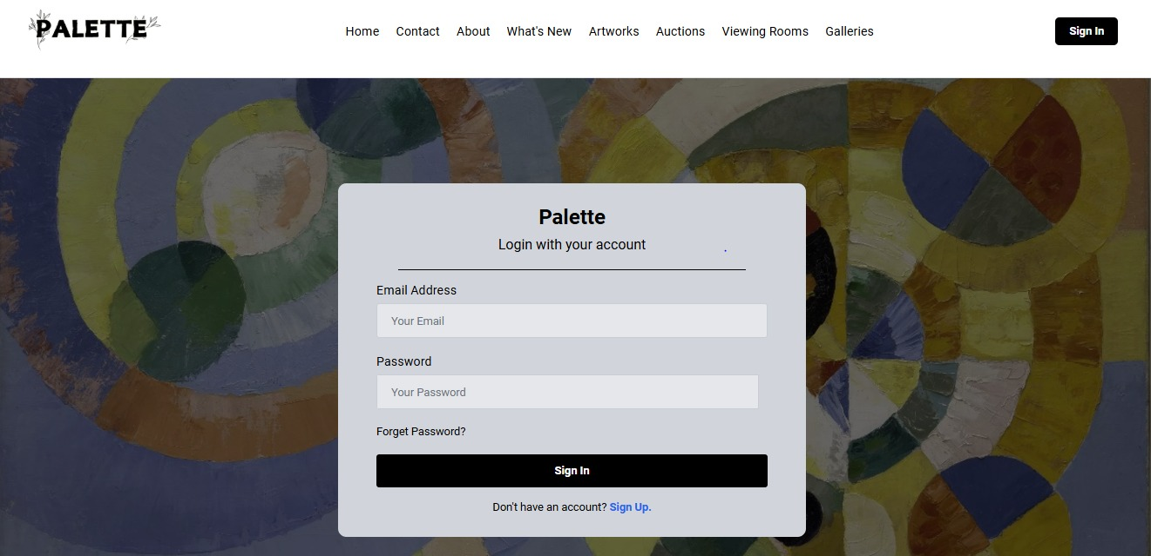
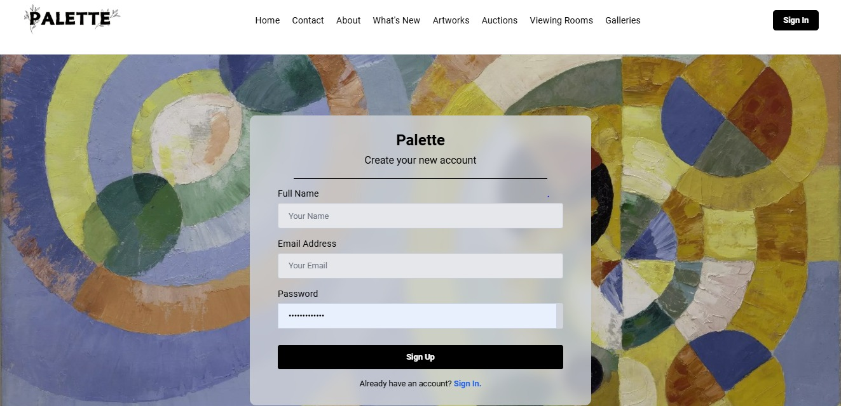
Our Design

Slide 13
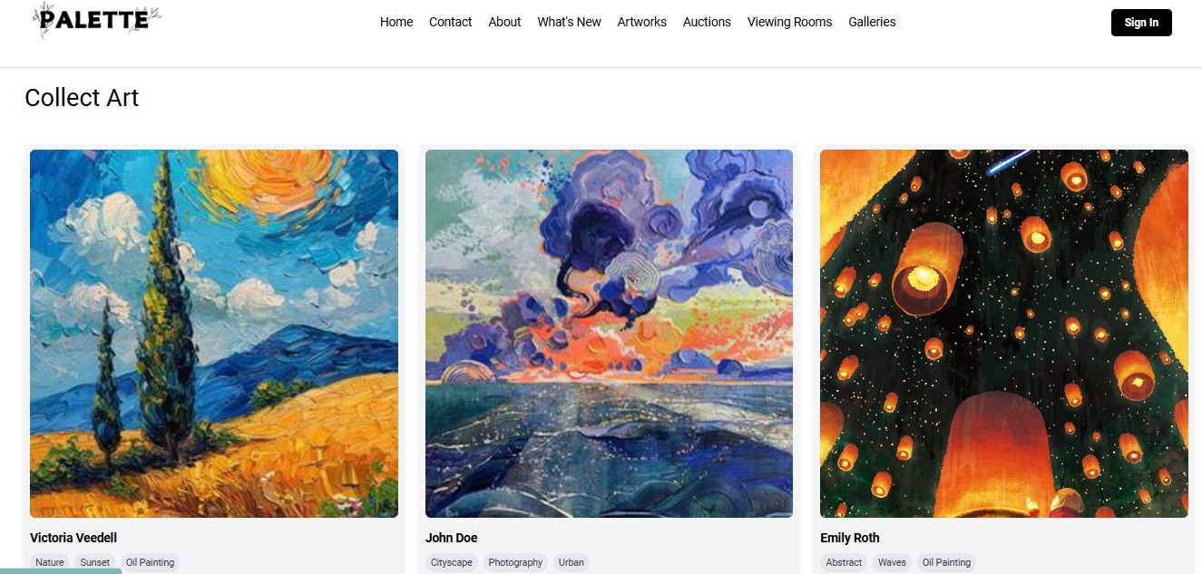
Our Design

Slide 14
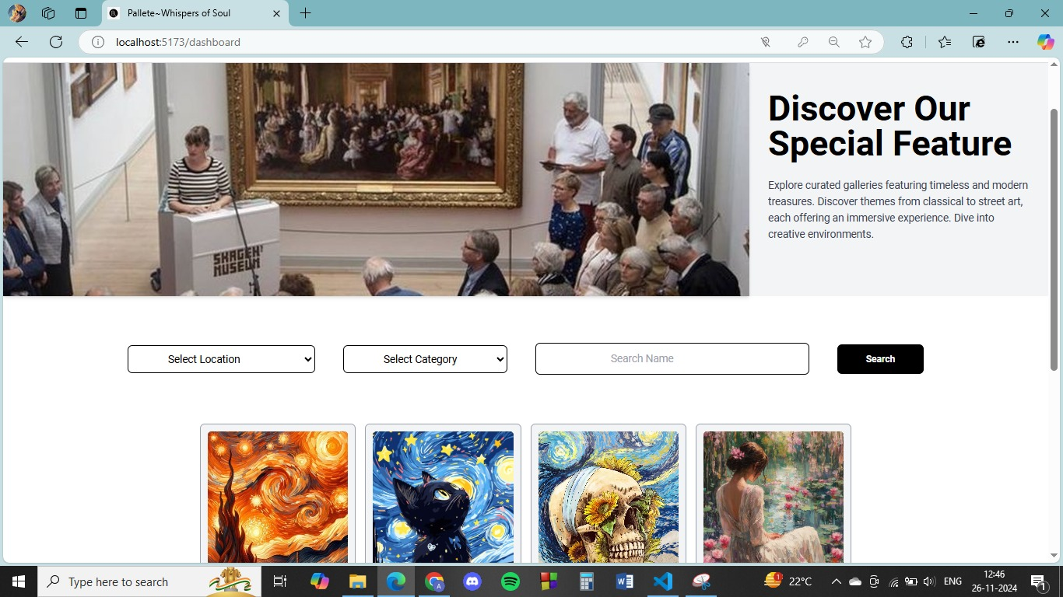
Our Design

Slide 15
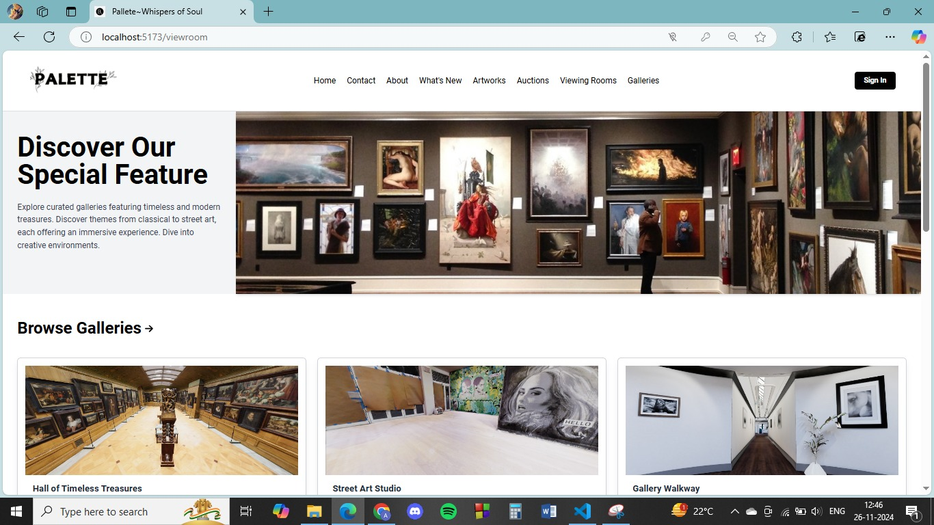
Our Design

Slide 16
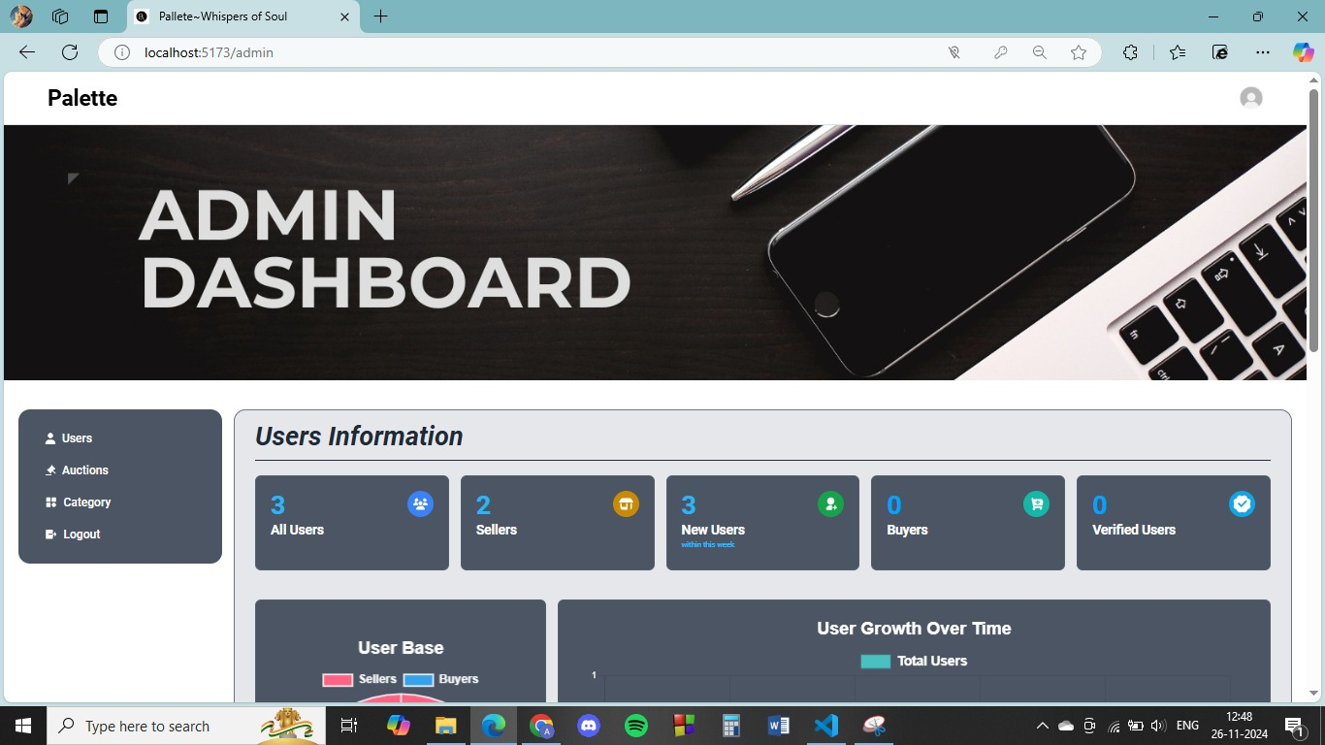
Our Design
Admin Dashboard

Slide 17
Future Scope
Mobile Application: Future development will include mobile applications for iOS and Android, allowing users to browse virtual galleries, place bids, and track auctions on the go, offering greater convenience and flexibility.
Multi-language Support: Expanding to offer multiple language options, enabling a wider global audience to engage with the platform in their native language, fostering inclusivity and accessibility.
Loyalty Program: A tiered loyalty program will reward frequent buyers, sellers, and bidders with points, special offers, and exclusive previews of new artwork, driving customer retention and repeat business.
Chatbot Integration: A smart AI-driven chatbot will provide instant assistance to users, answering queries about artwork, auction statuses, and payment details. This feature will enhance user experience by offering real-time support.

Slide 18
CONCLUSION
Palette consolidates key aspects of art auctioning and gallery management into one streamlined platform, marking a significant advancement in the art industry. It offers seamless artwork listing, bidding, and secure payment processing, ensuring a smooth experience for both artists and buyers while boosting operational efficiency.
With upcoming features like mobile accessibility, AI-powered recommendations, and a loyalty program, Palette is poised to become even more powerful and widespread. As the art market evolves, Palette will help galleries and artists meet growing demands for easier access, faster transactions, and a more personalized, engaging experience.
By enhancing resource management, increasing customer satisfaction, and providing a competitive edge in an ever-expanding art market, Palette will continue to be an essential tool for navigating the modern art landscape. The platform’s ability to integrate advanced technologies will ensure efficient and responsive operations, making it a cornerstone of the future of art auctions.

Slide 19
References/Links used
● https://www.mongodb.com/docs/
● https://expressjs.com/
● https://legacy.reactjs.org/docs/getting-started.html
● https://nodejs.org/docs/latest/api/
● https://redux.js.org/
● https://nodemailer.com/
● https://www.youtube.com
● Node.js Official Site
● https://redux.js.org/introduction/getting-started
● https://getbootstrap.com/docs/5.0/getting-started/introduction/
● https://mongoosejs.com/docs/guide.html
● https://webpack.js.org/concepts/
● https://learning.postman.com/docs/getting-started/introduction/

Slide 20


